Slide 1

Business Data Analysis
VX402 – Managing a Business
June 12th 2018
© 2018 JERRY ZHU ALL RIGHTS RESERVED

Slide 2
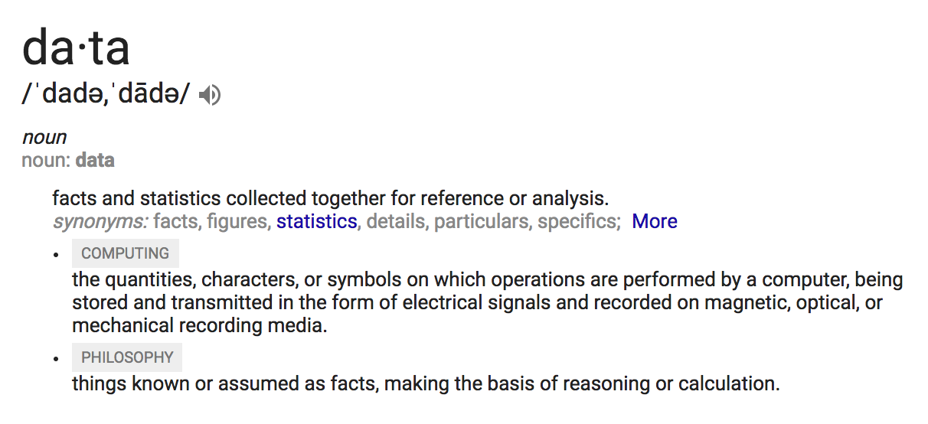
What is Data?

Slide 3
What is Big Data?
Big data is a term that describes the large volume of data – both structured and unstructured – that inundates a business on a day-to-day basis. But it’s not the amount of data that’s important. It’s what organizations do with the data that matters. Big data can be analyzed for insights that lead to better decisions and strategic business moves.

Slide 4
5 Words that Define Big Data
Volume. Organizations collect data from a variety of sources, including business transactions, social media and information from sensor or machine-to-machine data. In the past, storing it would’ve been a problem – but new technologies (such as Hadoop) have eased the burden.
Velocity. Data streams in at an unprecedented speed and must be dealt with in a timely manner. RFID tags, sensors and smart metering are driving the need to deal with torrents of data in near-real time.
Variety. Data comes in all types of formats – from structured, numeric data in traditional databases to unstructured text documents, email, video, audio, stock ticker data and financial transactions.

Slide 5
5 Words that Define Big Data
Variability. In addition to the increasing velocities and varieties of data, data flows can be highly inconsistent with periodic peaks. Is something trending in social media? Daily, seasonal and event-triggered peak data loads can be challenging to manage. Even more so with unstructured data.
Complexity. Today's data comes from multiple sources, which makes it difficult to link, match, cleanse and transform data across systems. However, it’s necessary to connect and correlate relationships, hierarchies and multiple data linkages or your data can quickly spiral out of control.

Slide 6
Why Is Big Data Important?
The importance of big data doesn’t revolve around how much data you have, but what you do with it. You can take data from any source and analyze it to find answers that enable:
Cost reductions
Time reductions
New product development and optimized offerings
Smart decision making

Slide 7
Big Data in Action - Examples

Slide 8

Example: Alibaba

Slide 9

In 2016 Double-11 Festival, Alibaba’s shopping platforms achieved a gross merchandise volume (GMV) of $17.8 billion, up from $14.3 billion the previous year, with a peak of 175,000 transactions and 120,000 payments per second.
The Festival showcases Alibaba’s innovations in key technology areas such as big data, cloud computing, artificial intelligence, and virtual reality.

Slide 10
Alibaba is not a E-commerce company. It’s a DATA company.
“
”
Here are five ways Alibaba is using data today:

Slide 11
User Experience
Alibaba uses the vast store of data it collects from its 423 million active buyers to generate personalized storefronts and product pages when consumers shop on Taobao Marketplace or Tmall.com. The feature is called “A Thousand People, A Thousand Faces” (千人千面), and merchants are using it to deliver not just product recommendations based on a visitor’s shopping history but also individualized virtual-storefront homepages geared for particular types of shoppers. According to figures from Alibaba, GMV from personalized shopping recommendations tripled in the company’s 2016 fiscal year.

Slide 12
Empowering Brands
Alibaba’s data can also be used to facilitate product development. Through the use of consumer purchasing and preference data, the company helps brands test new products and hone their marketing strategies.
For example, P&G used Alibaba to successfully test market a new sanitary napkin through an exclusive online launch on Tmall. Results prompted P&G to expand the availability of the product to offline retail outlets in China.

Slide 13
Digital Marketing
Historically, marketing has never been an exact science. But today Alibaba is using data to connect merchants with their most likely customers in a very targeted way. The company says it helped an unnamed snack brand nearly double its potential customer base in China by matching information on the brand’s existing customers with information on consumers in Alibaba’s database who had similar brand affiliations and similar purchase histories. The result: A higher click-through rate for a special promotion produced more purchases.

Slide 14
Logistics
Logistics isn’t just trains, planes and trucks. It’s data, too. The company’s delivery services, operated through Cainiao Network, provides express courier companies with routing information through its e-shipping label program, which is replacing a manual system with a more efficient, all-digital solution. The program increased the accuracy with which packages were sorted at warehouses and routed to their destinations, taking the successful delivery rate to 98 percent from 95 percent. Based on the 33 million packages each day that Cainiao delivered last year, the 3 percentage point improvement means that an extra 1 million packages reach their intended destination without issue—and Cainiao avoided the costs associated with the added fuel and labor necessary to collect and reship errant packages.

Slide 15
Financial Services
Alibaba affiliate company Ant Financial uses data to develop financial products such as consumer loans and insurance products, but it also parses that information to manage fraud risk and minimize its loss ratio. Ant Financial’s Alipay unit has a “payment graph”—much like Facebook’s social graph—that identifies patterns in relationships among users who make payments to each other. With this payment graph, along with algorithms Alipay uses to measure the credit risk of applicants, the online payments provider is able to maintain its bad-loan loss ratio at less than 0.001 percent.

Slide 16

Example: UPS
As a company with many pieces and parts constantly in motion, UPS stores a large amount of data – much of which comes from sensors in its vehicles. That data not only monitors daily performance, but also triggered a major redesign of UPS drivers' route structures. The initiative was called ORION (On-Road Integration Optimization and Navigation), and was arguably the world's largest operations research project. It relied heavily on online map data to reconfigure a driver's pickups and drop-offs in real time.
The project led to savings of more than 8.4 million gallons of fuel by cutting 85 million miles off of daily routes. UPS estimates that saving only one daily mile per driver saves the company $30 million.

Slide 17
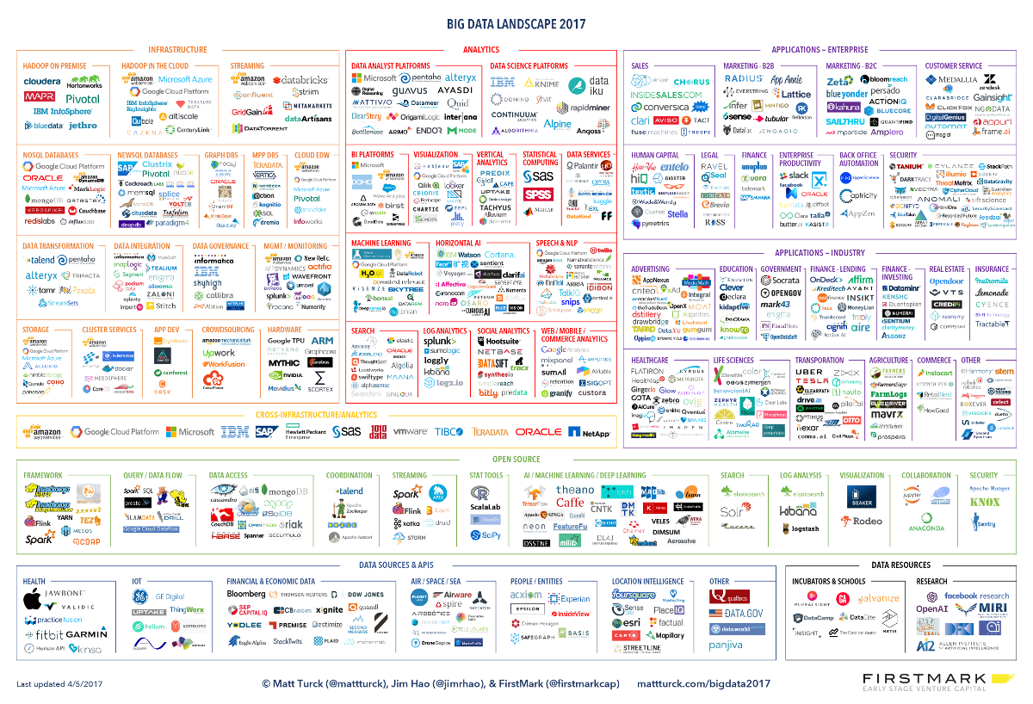

Slide 18
Please think of an example that illustrates the importance of Big Data…

Slide 19
What is Data Analysis?

Slide 20
What is Data Analysis?
Data analysis (also known as analysis of data or data analytics) is a process of inspecting, cleansing, transforming, and modeling data with the goal of discovering useful information, suggesting conclusions, and supporting decision-making.

Slide 21
The Process of Data Analysis
Data Requirements
Data Collection
Data Processing
Analyzing, Modeling and Algorithms
Communication

Slide 22
The Process of Data Analysis
Data Requirements
Data Collection
Data Processing
Analyzing, Modeling and Algorithms
Communication

Slide 23
Data Requirements
The data necessary as inputs to the analysis are specified based upon the requirements of those directing the analysis or customers who will use the finished product of the analysis. The general type of entity upon which the data will be collected is referred to as an experimental unit (e.g., a person or population of people). Specific variables regarding a population (e.g., age and income) may be specified and obtained. Data may be numerical or categorical.

Slide 24
Example: Product Sales Landscape
In 2016, XYZ consulting firm was invited by Coca-Cola Company to analysis the current product sales landscape to identify market competitiveness, penetration, and future opportunities…
Please think of a list of data you would require from Coca-Cola Company/ from the public market in order to make the analysis?

Slide 25
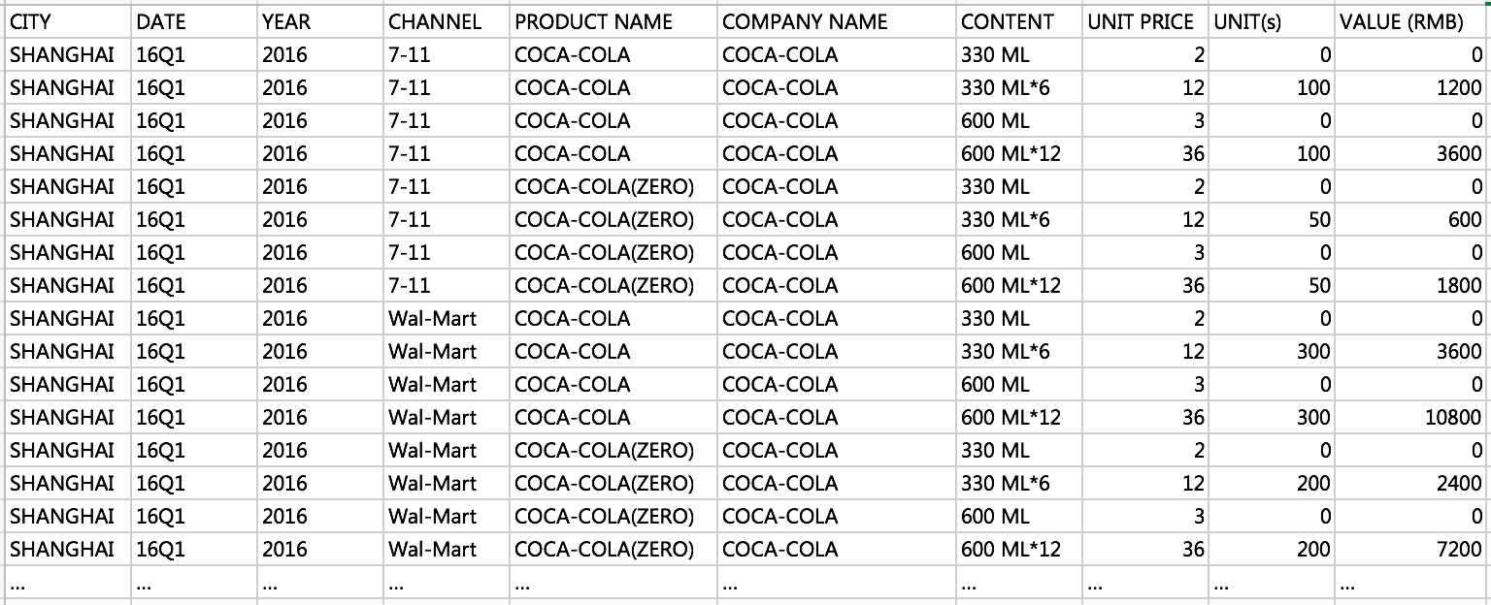
Sales data
- by product (Company C, Competitor 1, Competitor 2, etc.)
- by city
- by month
- by units (volume) and/or value (RMB)
- by distribution channel (if any)

Slide 26
The Process of Data Analysis
Data Requirements
Data Collection
Data Processing
Analyzing, Modeling and Algorithms
Communication

Slide 27
Data Collection
Data is collected from a variety of sources. The requirements may be communicated by analysts to custodians of the data, such as information technology personnel within an organization. The data may also be collected from sensors in the environment, such as traffic cameras, satellites, recording devices, etc. It may also be obtained through interviews, downloads from online sources, or reading documentation.

Slide 28
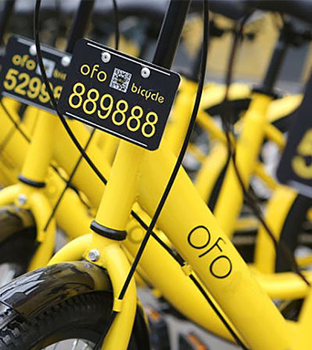
Example: Impact of ofo bike in SJTU
In May 2017, you were involved in a consulting firm, hired by a non-profit organization to analyze the impact of ofo bike in SJTU.
One of the key questions is to see whether the ofo bike actually improves the efficiency of human flow on the road in front of the No.2 Dining Hall.
In order to collect the data, what would you do?

Slide 29
Collect data from
- IoT smart devices
- Interviews with students and faculties
- Questionnaires
- what else?

Slide 30
The Process of Data Analysis
Data Requirements
Data Collection
Data Processing
Analyzing, Modeling and Algorithms
Communication

Slide 31
Data Processing
Data initially obtained must be processed, organised and cleaned for analysis. For instance, these may involve placing data into rows and columns in a table format (i.e., structured data) for further analysis, such as within a spreadsheet or statistical software.

Slide 32
Data Processing
Once processed and organized, the data may be incomplete, contain duplicates, or contain errors. Data cleaning is the process of preventing and correcting these errors. Common tasks include record matching, identifying inaccuracy of data, overall quality of existing data, deduplication, and column segmentation.

Slide 33
Data Processing – Checklist
Check each column whether they have unique and descriptive headers
Check whether each column is formatted consistently
Check for duplicate or missing rows
In case of text data, check whether the data are consistent in terms of case
Check for spelling errors
Check whether the data has extra spaces
Check whether the columns are arranged in the proper or logical order
Check whether any cells are blank that shouldn’t be blank

Slide 34
The Process of Data Analysis
Data Requirements
Data Collection
Data Processing
Analyzing, Modeling and Algorithms
Communication

Slide 35
Analyzing, Modeling and Algorithms
Mathematical formulas or models called algorithms may be applied to the data to identify relationships among the variables, such as correlation or causation. In general terms, models may be developed to evaluate a particular variable in the data based on other variable(s) in the data.
(Data Modeling and Algorithms class shall cover this part in more details)

Slide 36
The Process of Data Analysis
Data Requirements
Data Collection
Data Processing
Analyzing, Modeling and Algorithms
Communication

Slide 37
Communication (Data Visualization)
Once the data is analyzed, it may be reported in many formats. When determining how to communicate the results, the analyst may consider data visualization techniques to help clearly and efficiently communicate the message to the audience. Data visualization uses information displays such as tables and charts to help communicate key messages contained in the data. Tables are helpful to a user who might lookup specific numbers, while charts (e.g., bar charts or line charts) may help explain the quantitative messages contained in the data.

Slide 38
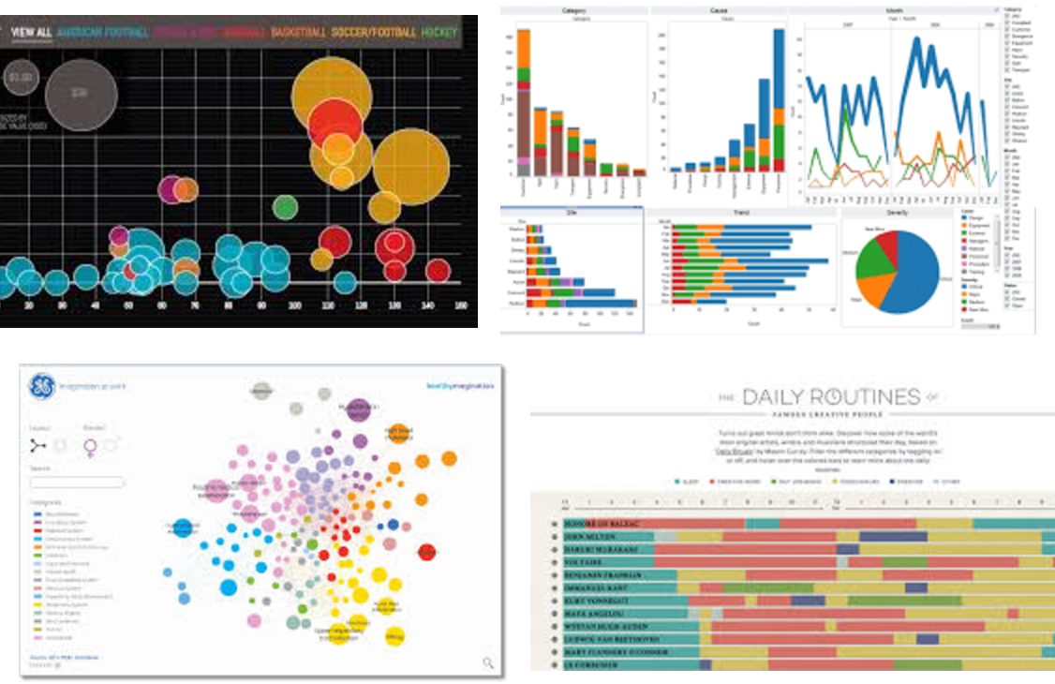
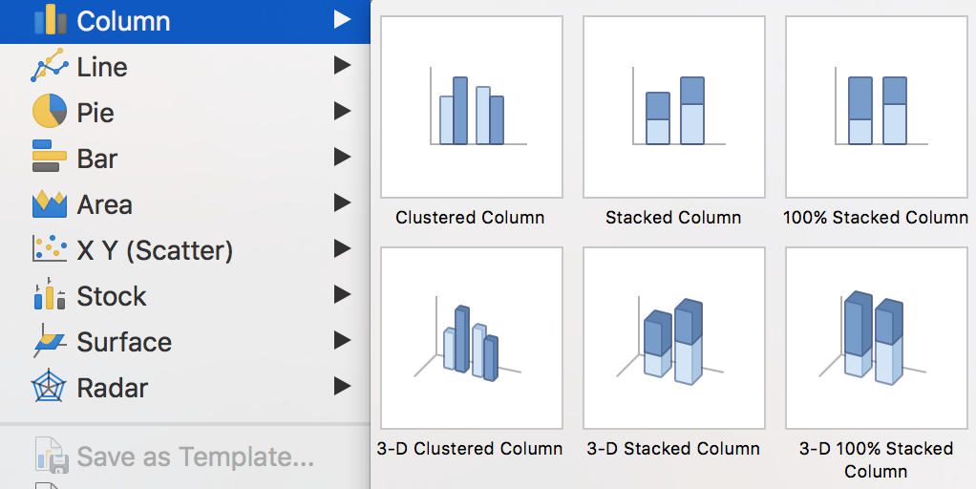
Which type shall I choose?

Slide 39
8 Types of Quantitative Messages
By Stephen Few

Slide 40
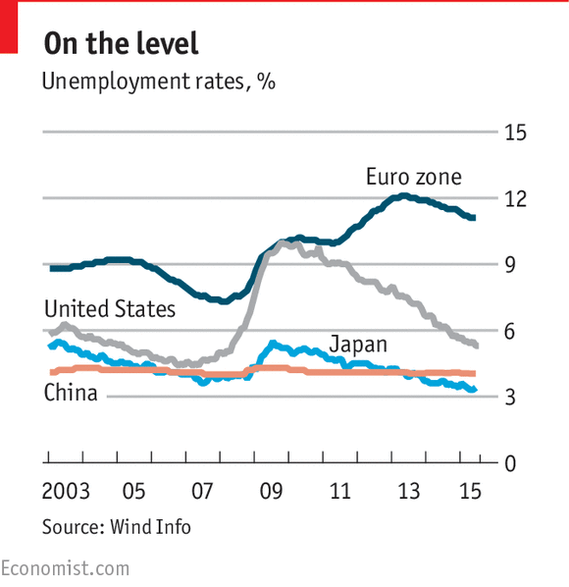
Time-series
A single variable is captured over a period of time, such as the unemployment rate over a 10-year period. A line chart may be used to demonstrate the trend.

Slide 41
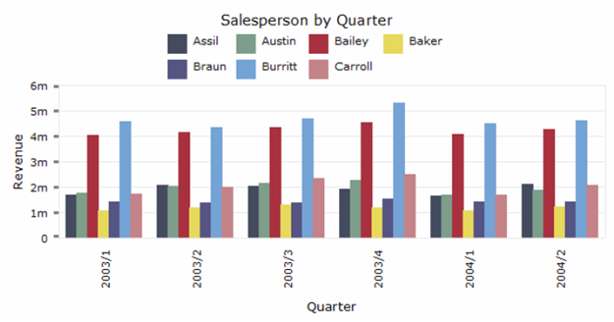
Ranking
Categorical subdivisions are ranked in ascending or descending order, such as a ranking of sales performance (the measure) by sales persons (the category, with each sales person a categorical subdivision) during a single period. A bar chart may be used to show the comparison across the sales persons.

Slide 42
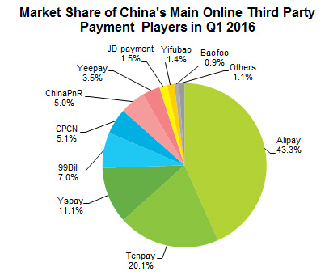
Part-to-whole
Categorical subdivisions are measured as a ratio to the whole (i.e., a percentage out of 100%). A pie chart or bar chart can show the comparison of ratios, such as the market share represented by competitors in a market.

Slide 43
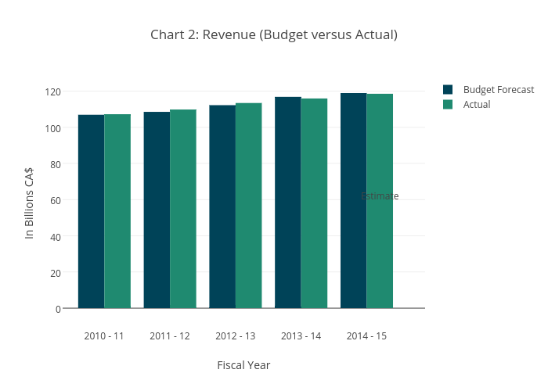
Deviation
Categorical subdivisions are compared against a reference, such as a comparison of actual vs. budget expenses for several departments of a business for a given time period. A bar chart can show comparison of the actual versus the reference amount.

Slide 44
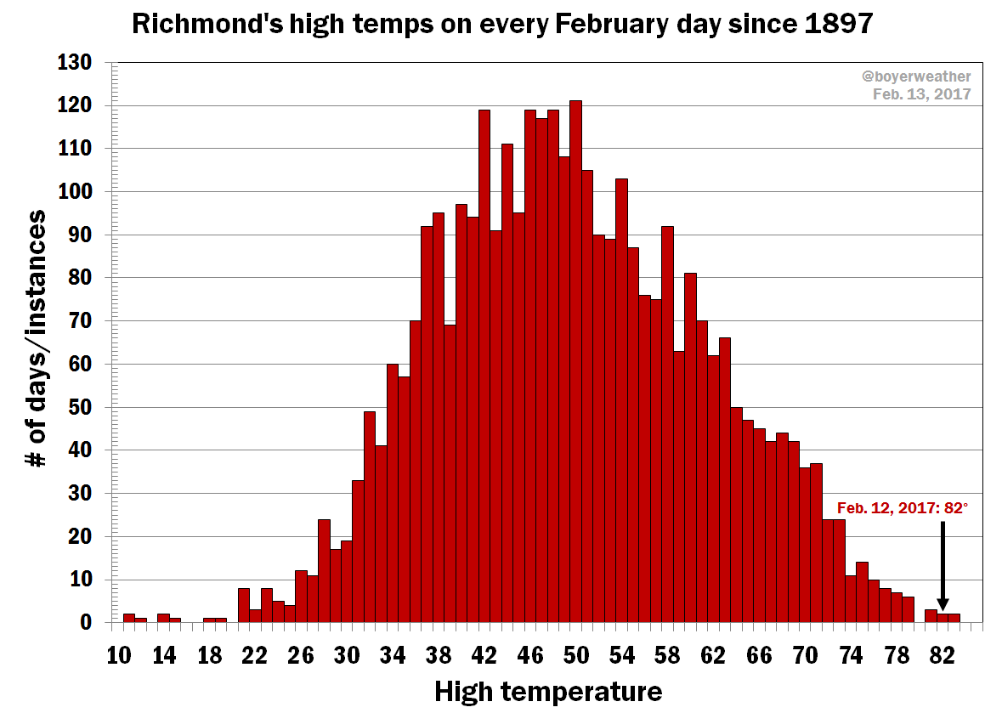
Frequency distribution
Shows the number of observations of a particular variable for given interval, such as the number of years in which the stock market return is between intervals such as 0-10%, 11-20%, etc. A histogram, a type of bar chart, may be used for this analysis.

Slide 45
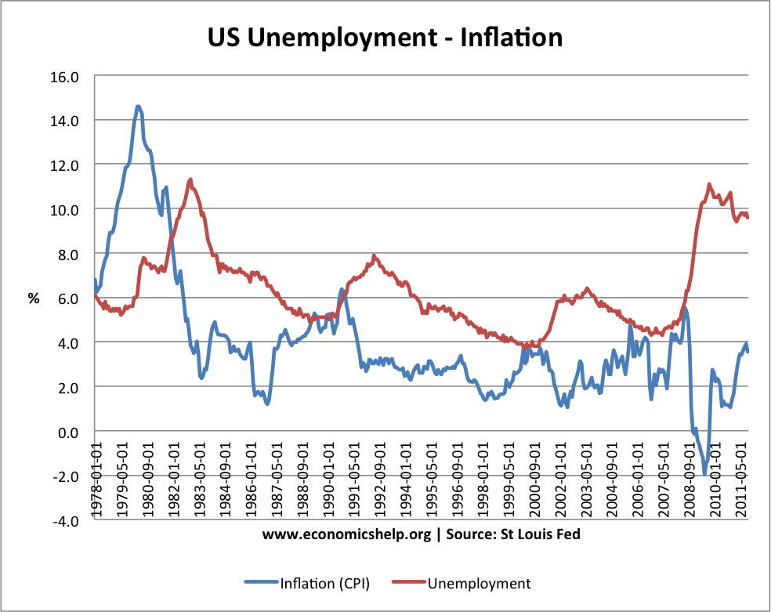
Correlation
Comparison between observations represented by two variables (X,Y) to determine if they tend to move in the same or opposite directions. For example, plotting unemployment (X) and inflation (Y) for a sample of months. A scatter plot is typically used for this message.

Slide 46
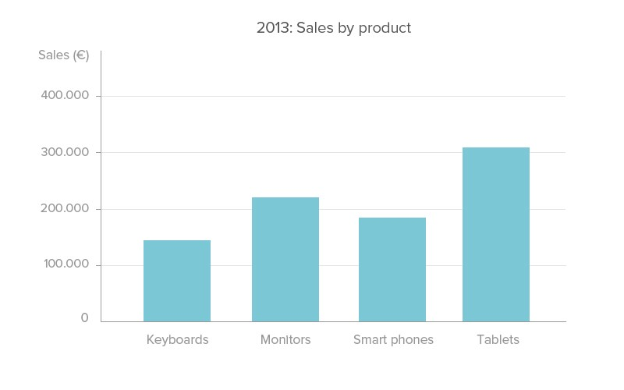
Nominal comparison
Comparing categorical subdivisions in no particular order, such as the sales volume by product code. A bar chart may be used for this comparison.

Slide 47
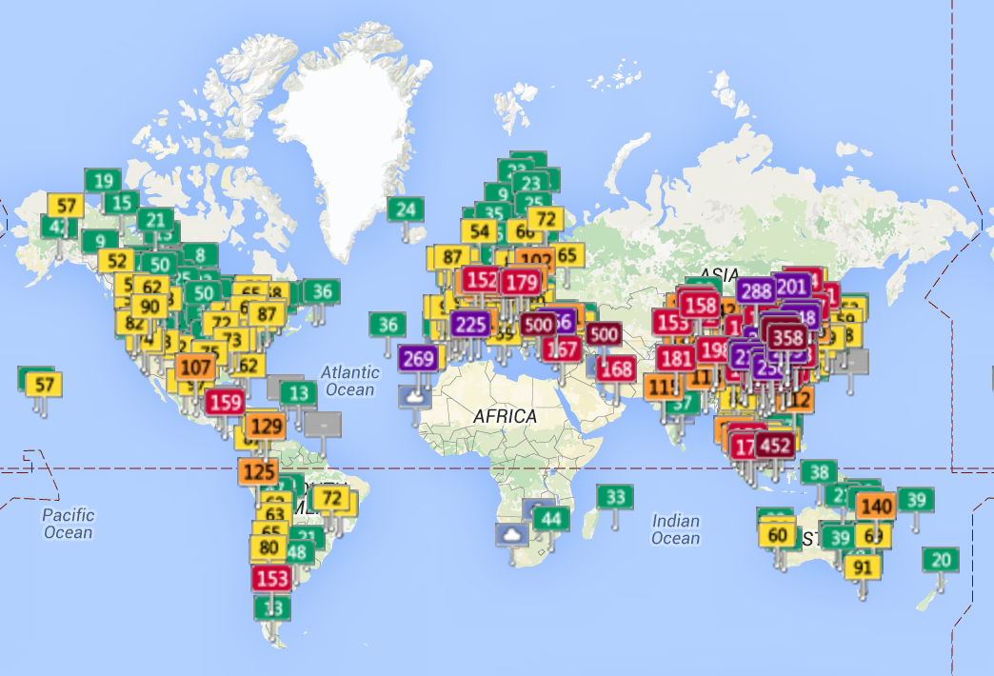
Geographic or geospatial
Comparison of a variable across a map or layout, such as the unemployment rate by state or the number of persons on the various floors of a building. A cartogram is a typical graphic used.

Slide 48
Next Steps
Thursday’s session…
A real business case
Solve the problem through data analysis
After Thursday’s session…
Identify a part of your own project using data analysis techniques
- What’s the objective of the data analysis?
- How to collect the data?
- How to analyze the data?
- What’s the best way to communicate the message?
Week 6, Tuesday and Thursday…
Present your own data analysis! (individual assignment, will be marked)

Slide 49
Thanks!
Jerry Zhu | jerry.zyn@gmail.com

